Slide 1
The Battle of the Neighbourhoods
IBM Data Science Professional Certificate

Slide 2
Problem Background
Darwin city is located in the Northern Territory of Australia. Darwin is one of the most remote cities in Australia.
Since 2012, Darwin has seen significant growth due to a very large gas project which has seen the economy boom, however the project is ending very soon and the economy is seeing the worst effects of the bust.
Private investment is going to be crucial in helping Darwin and the Northern Territory transition into a new economic phase, and to soften the effects of the bust.

Slide 3
Problem Description
Company XYZ Ltd (XYZ) is considering whether to open a new bar in the Darwin CBD.
XYZ is wondering whether right now is a good time to invest and open the bar considering the economic conditions.
Additionally, XYZ would like to know where in the Darwin CBD they should open the establishment if they choose to proceed.

Slide 4
Target Audience
The Target audience of this report is primarily XYZ, however any invest firm or individual thinking of opening a new nightlife establishment in Darwin CBD may be interested in this report.

Slide 5
Success Criteria
The success of this report will be based on whether XYZ can make a decision about where and when to invest in a new bar in the Darwin CBD.

Slide 6
Data Source Data 1
Foursquare API to generate a list of nightlife spots in the Darwin CBD
This data will help visualise where potential competitors are located, as well as if there are any nightlife hotspots in the Darwin CBD or areas to avoid or target.
This will help XYZ choose a desired location, and therefore solving the question as to where the new establishment would be if they choose to proceed.

Slide 7
Data Source Data 2
Australian Bureau of Statistics (ABS) indicators of Darwin and the Northern Territory. Those key indicators Australian Bureau of Statistics (ABS) are:
State Final Demand (SFD) (How much the Northern Territory produces within a period excluding net exports)
Unemployment Rate
Private Wage Growth Rate
Population
The data will give XYZ the opportunity to see trends and historical patterns to determine where the Darwin economy may go in the future.
This will give XYZ crucial information in deciding whether to invest in the economy to see if the economy is booming or heading into a bust period.

Slide 8
Methodology Data 1
The first data source generated a list of nightlife hotspots from Foursquare API. The data was gathered by using the venues search method, and specified the category ID to only include nightlife spots.
The data was then filtered and cleaned to ensure only applicable establishments were included. A map was then generated.
To explore further, k-means clustering techniques were applied to the data to separate venues into two clusters. A map was generated with these clusters to see if a nightlife hotspot existed in Darwin.

Slide 9
Methodology Data 2
The second data source was read from an excel file which contain all the information gathered from the ABS.
Each economic indicator was then plot on a line graph, in order to visualise the data and see the trends .
Pearson correlation techniques were used to see if any of the indicators were linked or moved together.
The analysis showed a strong relationship existed between two of the variables, and that the relationship should be taken into consideration when making the investment decision.

Slide 10
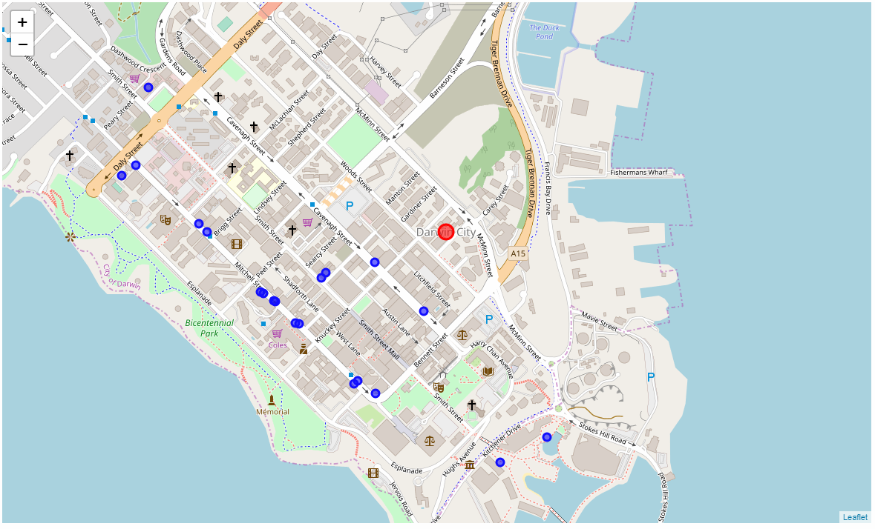
Results Data 1
The first map shows all the venues similar to XYZ’s proposed bar, a total of 20 venues were plotted. From the map it is clear that there appears to be a cluster of venues located on the same street.

Slide 11
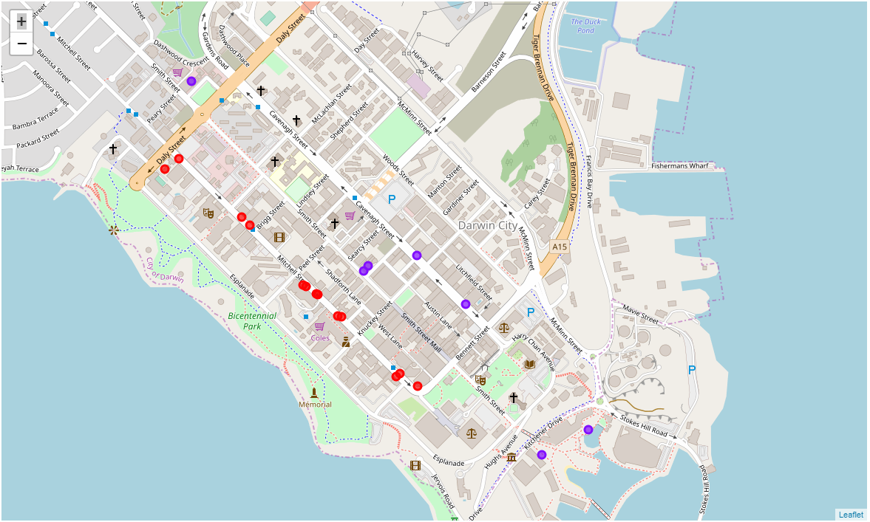
Results Data 1
K-means clustering techniques were applied to the data to separate venues into two clusters. The first cluster had venues that are located on Mitchell Street, and the second consisted of venues that were not located on Mitchell Street.

Slide 12
Results Data 1
Cluster 0: Venues on Mitchell Street
The fist cluster consisted of 13 venues out of a total 20 (65%). This clearly shows most venues are located on Mitchell Street.
Cluster 1: Venues not on Mitchell Street
The second cluster consisted of 7 venues out of a total 20 (35%). Not many venues in the Darwin CBD are outside of the main nightlife hotspot.

Slide 13
Results Data 2
Each economic indicator was plotted in a line graph in order to visualise each indicator, and to see if there are any apparent trends heading into the future.

Slide 14
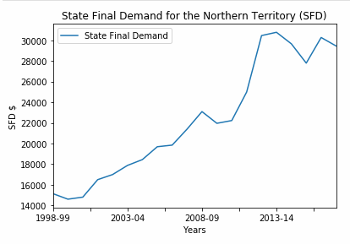
Results Data 2 – State Final Demand
The figure shows SFD, which has declined and remain subdued in recent years. This indicates that the economy in the Northern Territory is weak.

Slide 15
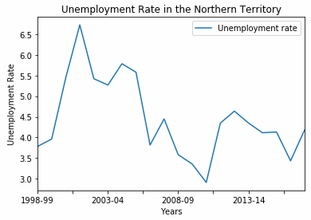
Results Data 2 – Unemployment
The figure shows the unemployment rate, which has increased in recent years. This indicates that the economy in the Northern Territory is weak.

Slide 16
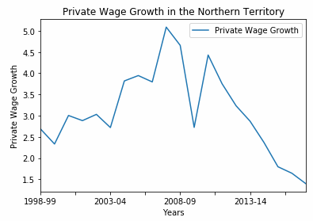
Results Data 2 – Private Wage Growth
The figure shows private wage growth, which has declined significantly in recent years. This indicates that the economy in the Northern Territory is weak.

Slide 17
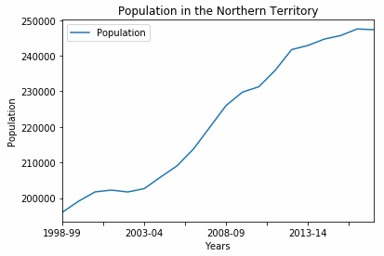
Results Data 2 – Population
The figure shows population, which has flattened in recent years. This indicates that the economy in the Northern Territory is weak.

Slide 18
Results Data 2 – Pearson Coefficients
The table shows the Pearson coefficients between the variables. As it shows, a very strong relationship exists between SFD and population.
A relationship does not exist between unemployment rate and private wage growth, this may be due to a large proportion of the labour force in Darwin being employed by the state government.
Economic Indicators | Pearson Coefficient
Population & SFD | 0.97
Unemployment Rate & Private Wage Growth | 0.04

Slide 19
Discussion
From the results, it is clear that there is a nightlife hotspot on Mitchell Street in Darwin CBD.
The economic indicators all point to a stalling or possibly declining economy. The graphs al reflect a period of booming economic growth, this is now being followed by subdued growth and may lead to negative growth.
My recommendation to XYZ is to not open a new bar at this point in time.

Slide 20
Conclusion
The report considered locational data provided by Foursquare API of venues in the Darwin CBD, as well as economic indicators to give XYZ relevant information before making their investment decision.
The data showed that a nightlife hotspot exists in Mitchell Street, and that the Northern Territory economy is in a period of bust or contraction.
Therefore it is recommended that XYZ delay their investment of establishing a new bar until the economy rebounds.

Slide 21
Thanks for Viewing
Presentation by Brett Totham

